Slide 1

Project Review Meeting
A
on
Pharmacy Inventory Management
By
Name ARNAV CHITIKENA
Name V SRI VAISHNAVI
roll 2520030331
roll 2520090117
Team Number: 33
Under the guidance of
Dr. Nirmala Jyothi
Associate Professor
Department of Computer Science and Engineering
Koneru Lakshmaiah Education Foundation
(Deemed to be University estd. u/s. 3 of the UGC Act, 1956)
Off-Campus: Bachupally-Gandimaisamma Road, Bowrampet, Hyderabad, Telangana - 500 043.
Phone No: 7815926816, www.klh.edu.in

Slide 2
Outline of the Presentation
Abstract
Introduction
Problem Statement
Project Flow Diagram
Objectives with Justification
Modules[Frontend web pages]
Expected Outcomes of the Proposed Work
Conclusion
References

Slide 3
Abstract
The Pharmacy Inventory Management System is a web-based application built using React and JavaScript that automates and simplifies pharmacy stock operations. It features role-based access control with an Admin role for full management and standard roles for read-only access. Core functionalities include real-time stock monitoring with low-stock and out-of-stock alerts, automated expiry date notifications, supplier order management, a medicine dispense log, and barcode-based drug lookup. An analytics dashboard powered by Chart.js provides visual reports on stock levels, dispensing trends, and top-consumed medicines. Data is stored locally via browser localStorage with support for CSV and PDF export. The system aims to minimize manual errors, prevent stock-outs, and improve overall pharmacy inventory efficiency.

Slide 4
Introduction
Managing pharmacy inventory manually is time-consuming and prone to errors, leading to stock-outs and medicine wastage. The Pharmacy Inventory Management System is a web-based application built using React, and JavaScript to automate these operations. It provides a centralized dashboard for monitoring real-time stock levels, expiry alerts, supplier order management, dispense logging, and barcode-based drug lookup. A role-based access system distinguishes Administrators from standard users such as Pharmacists and Store Managers. An integrated Chart.js analytics module visualizes stock and dispensing trends, with CSV and PDF export support. The system aims to improve accuracy and efficiency in pharmacy operations.

Slide 5
Problem Statement
Pharmacies that rely on manual inventory management face challenges such as stock-outs, medicine expiry losses, inaccurate dispensing records, and delayed supplier reorders. The absence of a centralized system makes it difficult to monitor real-time stock levels, track expiry dates, and maintain proper dispensing logs, leading to operational inefficiencies and potential patient safety risks. There is a need for an automated, role-based pharmacy inventory system that can track stock in real time, generate expiry and low-stock alerts, manage supplier orders, log dispense records, and provide analytical insights to support better decision-making in pharmacy operations.

Slide 6
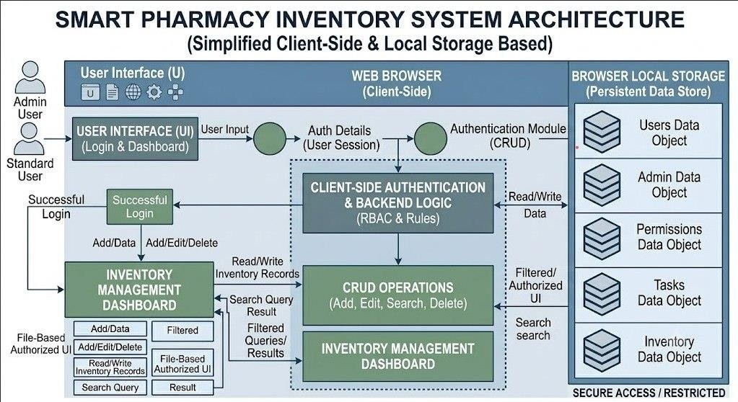
Project Flow Diagram

Slide 7
Objectives with Justification
1. Real-Time Stock Monitoring To track current medicine quantity and status (In Stock, Low Stock, Out of Stock), preventing stock-outs and ensuring medicine availability at all times.
2. Expiry Date Alerts To automatically notify staff about medicines nearing or past expiry, reducing wastage and ensuring patient safety.
3. Supplier Order Management To streamline the reordering process when stock falls below threshold, ensuring timely replenishment from suppliers.
4. Dispense Log Maintenance To record every medicine dispensed with customer and prescription details, ensuring accountability and audit readiness.

Slide 8
Modules [Frontend web pages]
1. Home Page Module The landing page displays the system's key features and provides access to Login and Sign Up options. It serves as the entry point for all users.
2. Authentication Module Handles user Login, Sign Up, and Password Reset functionalities. Validates credentials, assigns roles, and routes users to their respective dashboards based on their access level.
3. Stock Management Module Allows administrators to add, edit, and delete medicine records including barcode, name, category, quantity, price, threshold, expiry date, and supplier details. Displays real-time stock status badges.
4. Expiry Tracking Module Lists all medicines with their expiry dates and remaining days. Highlights expired and soon-to-expire medicines, enabling timely action by pharmacy staff.

Slide 9
Expected Outcomes of the Proposed Work
1. Improved Stock Visibility The system will provide real-time visibility into medicine stock levels, enabling pharmacy staff to instantly identify in-stock, low-stock, and out-of-stock medicines, eliminating guesswork in inventory management.
2. Reduced Medicine Wastage Automated expiry alerts will notify staff well in advance about medicines nearing expiry, allowing timely action and significantly reducing medicine wastage and financial losses.
3. Elimination of Stock-Outs Smart reorder alerts triggered when stock falls below the defined threshold will ensure timely replenishment, preventing stock-outs and ensuring continuous medicine availability.
4. Accurate Dispensing Records A structured dispense log will maintain complete and accurate records of every medicine dispensed, improving accountability, traceability, and audit readiness.

Slide 10
Conclusion and Future Scope
Conclusion
The Pharmacy Inventory Management System successfully automates key pharmacy operations including stock monitoring, expiry tracking, supplier ordering, dispense logging, and analytics. It reduces manual errors, prevents stock-outs, and improves overall efficiency through a role-based, user-friendly web interface.
Future Scope
In the future, the system can be enhanced with a backend database for persistent multi-user data storage, SMS or email notifications for expiry and reorder alerts, barcode scanner hardware integration, and mobile application support. AI-based demand forecasting can be incorporated to predict stock requirements, and integration with billing and patient management systems can make it a complete pharmacy solution.

Slide 11
CO –Mapping of the project
CO1:Foundations
Component-driven architecture Unidirectional data flow
React state updates
Reusable components
Declarative UI
Components like:
AdminDashboard.jsx
UserDashboard.jsx
StockList.jsx
ExpiryAlerts.jsx
SupplierOrders.jsx
CO2:JavaScript
ES6 Import/Export
Arrow Functions
Destructuring
Async JavaScript
Modular Design
Closures
Local Storage
CO3: React Component Model
Topics Used
Functional Components
Props
State
useState
useEffect
useRef
Component Composition
Reusable Components

Slide 12
CO5: Routing, Forms, Accessibility & Performance
Topics Used
Controlled Forms
Form Validation
Context API
Browser Storage
User Authentication Forms
CO4: Topics Used State Architecture
React Context API
Global State Management
State Lifting
useContext
Async Operations
Local Storage Persistence
CO6
Vite ESLint, Build System

Slide 13
References
1. Books
[1] Satyanarayana, U. and Chakrapani, U., Pharmaceutical Management, 2nd ed., Elsevier India, 2018.
[2] Duckett, J., JavaScript and JQuery: Interactive Front-End Web Development, 1st ed., Wiley, 2014.
2. Journals and Research Papers
[4] Agboola, S. et al., "Pharmacy Inventory Management Using Automated Systems," Journal of Pharmacy Practice, vol. 12, no. 3, pp. 45–52, 2020.
[5] Kumar, R. and Singh, P., "Web-Based Inventory Management System for Healthcare," International Journal of Computer Applications, vol. 175, no. 2, pp. 18–24, 2021.

Slide 14



